Slide 1


Department of Information Technology
IoT based Automatic Vehicle Accident Alert System
Sanika Bhanushali Rohit Mule
Shrey Shaparia
[EU1204034] [EU1204010] [EU1204013]
Mrs. Maya Patil | Designation
Feb 3rd , 2024

Slide 2

CONTENTS
Abstract
Introduction
Literature Review
Problem Statement
Scope
Proposed System (Block diagram)

Slide 3
Abstract
The IoT-based Automatic Vehicle Accident Alert System represents a pivotal advancement in road safety technology. This system employs a network of interconnected sensors, real-time data analysis, and seamless connectivity to automatically detect and respond to vehicle accidents. When an accident occurs, the system is rapidly identifying the incident and promptly transmits an alert to emergency services. This real-time communication facilitates swift response times, potentially mitigating the severity of injuries and saving lives. The system's primary goal is to reduce accident-related fatalities and enhance overall road safety by revolutionizing accident detection and response mechanisms. This abstract provides a glimpse into a transformative solution that aims to make road travel safer for all.

Slide 4
Introduction
The high demand of automobiles has also increased the traffic hazards and the road accidents. Life of the people is under high risk. This is because of the lack of best emergency facilities available in our country. An automatic alarm device for vehicle accidents is introduced in this paper. This design is a system which can detect accidents in significantly less time and sends the basic information to first aid centre within a few seconds covering geographical coordinates, the time and angle in which a vehicle accident had occurred.
The IoT-based Automatic Vehicle Accident Detection and Alert System is a cutting-edge technology designed to swiftly identify accidents and alert authorities. By integrating sensors and GPS, it detects abrupt changes indicative of an accident and promptly notifies emergency services and contacts. This system significantly reduces response times, enhancing the chances of survival and recovery for accident victims, ultimately revolutionizing road safety.

Slide 5
Literature Review
Sr. No. | Paper Title [Ref.] | Author names | Conclusion | Research Gaps
[1] | A survey on IoT Automatic Road accident Detection | Suraj Pratap Shubham, Madan Kumar, Rajkishor, Dr.Sarika Jain | These strategies used various sensors for accident detection, including accelerometers, pressure sensors, and machine learning algorithms, including neural networks, support vector machines, and classification algorithms.. | A significant research in this is need to investigate and develop accident detection systems that are robust and resilient to hardware or software failures caused by collisions. Also address the critical issue of ensuring the continued accuracy and performance of such systems, even under adverse conditions, ultimately contributing to enhanced road safety

Slide 6
Literature Review
[2] | Automatic Messaging System by detecting the road accident for vehicle application | M.Karthik, L.Sreevidya, K.Vinodha, M.Thangara, G.Hemalath, T.Viswak Sena | The accident alert and detection project’s major goal is to try to minimize the number of people who die in accidents. Whenever accident is identified by the system, a medical team is sent to the location to improve the chances of survival. | The need to investigate the real-world effectiveness, response times, and user acceptance of the described vehicle accident detection and alert system. Addressing potential privacy and security concerns related to continuous vehicle data monitoring is also a critical area for further research.
[3] | System For Accident Detection And Prevention | Mona Chikte, Devika Sarkar, Ramesh Sarkar, Prof.Abhijeet Thakare | It has been acknowledged that managing the smartphone-based auto accident detection system is not simple. The researchers are coming up against a lot of barriers that keep them from developing a detection system that is 100 percent reliable. The system's primary goal is to locate the closest emergency locations from the scene of the accident. This was accomplished by utilizing a function that both Google Maps and the GPS receiver offer. | The need to address the challenges and limitations With smartphone-based auto accident detection systems, particularly their reliability and accuracy. Further research could focus on improving the robustness of such systems in various real-world scenarios and Exploring potential enhancements to ensure timely and accurate accident detection and notification

Slide 7
Literature Review
[4] | Iot-Based Vehicular Accident Detection Systems | Mahziar Mohammadrezaei, Hamed Shahbazi Fard,Reza Pourmohammadhos ein Niaky, Behnam Soltani | In this paper, new methods for car accident detection based on IoT are analyzed and their characteristics, advantages and disadvantages are compared.The hardware requirements of such systems are the biggest obstacle to their implementation and widespread use because they may not be economically viable. To implement this system, communication channels between private companies and aid organizations must be very powerful. If governments and private companies work together to implement this system, it can save many lives. | The need for further exploration into the practical implementation challenges and cost-effectiveness of IoT-based smart accident detection systems. Investigating the economic viability, scalability, and collaborative efforts required for widespread adoption and efficient communication between relevant authorities could be valuable areas for research.
[5] | IoT Based Automatic Vehicle Accident Detection And Rescue System | R Amudha, Arnave B Pradeep, Shibil Roshan M P, Vijeesh A | The system provides the design which has the advantages of low cost, portability and small size. It consists of vibration sensor, GPS and IOT interfacing which reduces the accident .It also overcomes a lot of problems of automated system for accident location detection. | Exploring Real-world Implementation Challenges and User Acceptance: While the system's concept is promising, there's a need for research that investigates the practical challenges and user acceptance of such systems in real-world scenarios.

Slide 8
Literature Review
[6] | Automatic Vehicle Accident Detection And Messaging System Using GPS and GSM Modems | Sri Krishna Chaitanya Varma, Poornesh, Tarun Varma, Harsha | A working model of Automatic vehicle accident detection and messaging system using a GPS and GSM modems has been implemented successfully. The biggest advantage of our research is, whenever the sensor is activated we will be immediately getting the acknowledgement from GSM modem to our mobile numbers which are stored in EEPROM, without any delay. This system locates the accident spot accurately, realizing the automation of accident detection and messaging system. Consequently, it will save the precious time required to save the accident vic- tims. Further this system can be implemented using the vibra- tion sensors as well as the sound sensors, in order to make it more accurate and efficient to detect an accident | The need for a comprehensive evaluation of the real-world effectiveness and reliability of the proposed Automatic Vehicle Accident Detection and Messaging System. This would involve assessing its performance in various conditions, its ability to accurately detect accidents using different types of sensors (vibration, sound), and the user experience with the system. Additionally, research could explore potential enhancements or alternatives to improve the speed and accuracy of accident detection further.

Slide 9
Problem Statement
Develop an IoT-based Automatic Vehicle Accident Alert System that can detect accidents using accelerometers and collision sensors, transmit real-time alerts via a secure and efficient communication protocol, track accident locations through GPS, and provide a user-friendly interface for vehicle owners while optimizing power consumption and ensuring data privacy and security. The system should seamlessly integrate with emergency services, offer backup and redundancy mechanisms, scale across various vehicle types, remain cost-effective, and adhere to relevant regulatory standards, ultimately enhancing road safety by expediting response times and improving emergency services' effectiveness in accident situations.

Slide 10
Scope
The scope of the IoT-based Automatic Vehicle Accident Alert System project encompasses the design and development of both hardware and software components. This includes the integration of sensors such as accelerometers, gyroscopes, collision sensors, heat & humidity sensor and GPS technology to accurately detect vehicle accidents and determine their precise locations. The system will employ custom software to process sensor data, trigger real-time alerts, manage communication protocols, and offer a user-friendly interface for vehicle owners. Special attention will be given to optimizing power consumption, ensuring the privacy and security of accident data through encryption and access control mechanisms, and seamless integration with emergency services. Moreover, the system will be adaptable to various vehicle types and cost-effective while adhering to relevant regulatory standards. The project aims to significantly enhance road safety by expediting accident response times and improving the overall effectiveness of emergency services in accident situations.

Slide 11
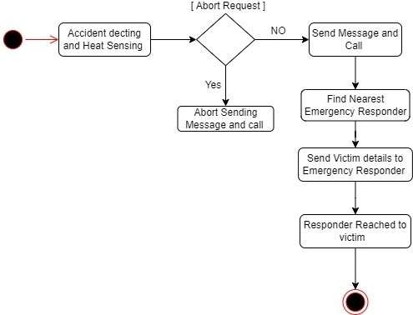
Proposed System
Block Diagram

Slide 12
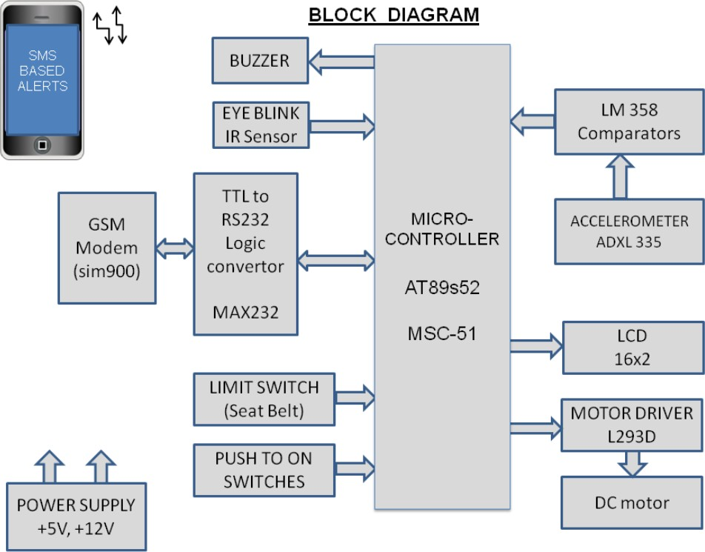
Proposed System

Slide 13
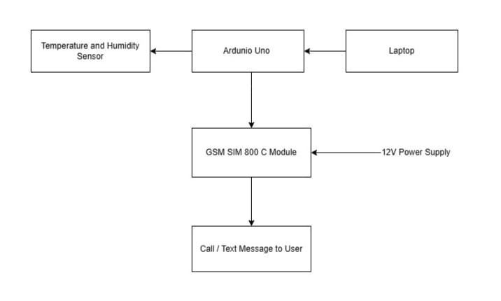
Implementation
Flow Chart

Slide 14
Implementation

Slide 15
Implementation

Slide 16
Result and Discussion
An IoT-based Automatic Vehicle Accident Alert System is designed to swiftly detect and respond to vehicle accidents, offering benefits such as real-time accident detection, rapid alerts to emergency services, reduced response times, improved accuracy in differentiating accidents from false alarms, precise location tracking, valuable data for traffic safety analysis, heightened driver safety awareness, potential insurance incentives, and legal documentation. The system's effectiveness depends on the technology employed, integration with emergency services, network reliability, and regulatory considerations, and specific results would be contingent on individual implementations and evaluations.

Slide 17
Conclusion
In conclusion, an IoT-based Automatic Vehicle Accident Alert System has the potential to make significant strides in enhancing road safety and emergency response. By promptly detecting accidents and efficiently alerting emergency services, these systems can save lives and reduce the severity of injuries. Furthermore, they contribute to data-driven insights for traffic safety improvements. While the effectiveness of such systems can vary based on the technology and implementation, the overall impact is a move toward safer roads and a more effective emergency response infrastructure, ultimately leading to a reduction in accidents and their associated human and economic costs.

Slide 18
References
Mohan, S., Rengarajan, N., & Saranya, A. (2016). IoT Based Accident Detection and Reporting System for Smart City. International Journal of Innovative Research in Computer and Communication Engineering, 4(8), 15910-15916.
Soni, P., & Sharma, S. K. (2017). IoT Based Vehicle Accident Detection and Notification System. International Journal of Advanced Research in Computer and Communication Engineering, 6(4), 118-121.
Azeez, S. A., Ananth, G. N., & Asokan, G. (2018). Real-Time Vehicle Accident Detection and Notification System Using IoT. International Journal of Innovative Technology and Exploring Engineering, 7(6), 1810-1812.
Hsu, C. W., Chen, T. H., & Huang, C. H. (2019). IoT-Based Smart Vehicle Accident Detection System. IEEE Transactions on Industrial Informatics, 15(5), 3115-3123.
Sivaramakrishnan, S., & Srinivasan, K. (2020). IoT-Enabled Vehicle Accident Detection and Alert System. Procedia Computer Science, 171, 122-129.

Slide 19
References
Wang, S., & Wang, X. (2021). A Comprehensive Review of IoT-Based Vehicle Accident Detection Systems. IEEE Access, 9, 12840-12853.
Albalushi, A. A., Al-Sultan, S., & Al-Muhtadi, J. (2022). Real-Time Vehicle Accident Detection System Using IoT and Cloud Computing. Sensors, 22(8), 2468.
Bello, O. A., & Mok, W. Y. (2022). Enhanced Vehicle Accident Detection and Notification System Using Machine Learning in IoT. Computers & Electrical Engineering, 99, 107270.
Garg, S., & Chhabra, P. (2023). IoT-Based Accident Detection and Notification System with Edge Computing. Journal of Ambient Intelligence and Humanized Computing, 1-13.
Li, X., Liu, B., Liu, K., Zeng, S. (2018). Vehicle Accident Detection and Monitoring System Using IoT and Cloud. IEEE Internet of Things Journal, 5(1), 24-32.

Slide 20
Thank You !!!

Slide 21
Q& A

